Slide 1
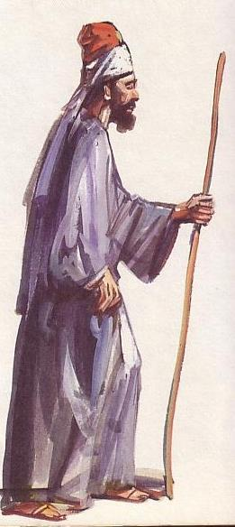
Ancient Near East Peoples
71
Rationale
Overview
Geography
Peoples
Dr. Rick Griffith • Jordan Evangelical Theological Seminary • BibleStudyDownloads.org

Slide 2
Rationale:
Why Study ANE Peoples?
71
Exegete OT Scripture
  Genesis 12:1-3—Why did Abraham leave Ur with his entire family?
  1 Samuel 13:19—Why did the Israelites go to the Philistine camp to sharpen their weapons to use against them?
  Psalm 29:3—Why does the psalmist claim that the LORD is "above the waters"?

Slide 3
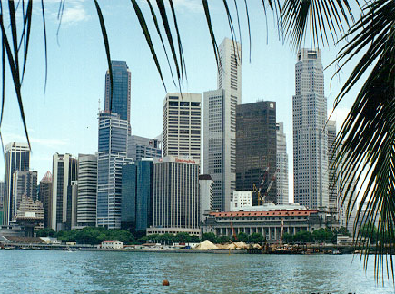
Rationale:
Why Study ANE Peoples?
71
Exegete Present Culture
  What cultural values of unbelievers do you observe in this country?
  How do these values differ from your own?

Slide 4

ANE History (An Overview)
73
Mesopotamia
Syria-Palestine
Egypt
Notes:
ANE history by culture begins with the dispersion of peoples from Babel in Genesis 11. Whereas the descendants of Japheth migrated north (red), the sons of Ham (green) and Seth (blue) remained within the Fertile Crescent and became three great regions: Egypt, Syria-Palestine, and Mesopotamia. We will briefly study ANE peoples in each of these three regions. OTB, 73 notes how each region has a different historical designation by time period.

Slide 5
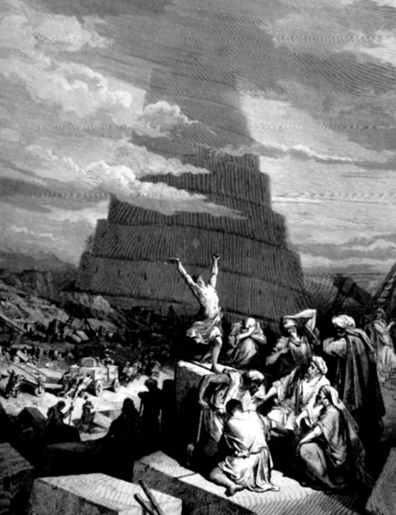
God again judges man's base heart
Nations & languages result from sin
God graciously preserves man
Genesis 11

Slide 6
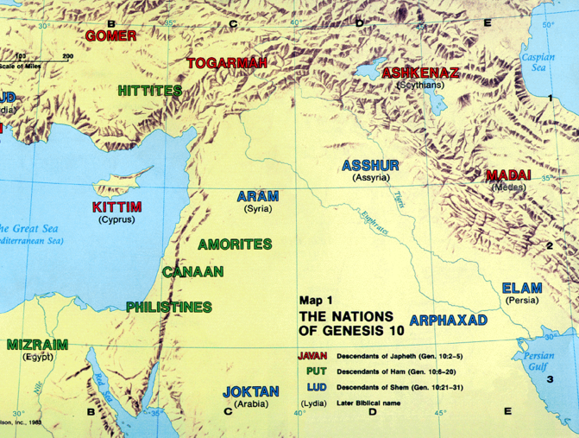
ANE Geography
JAPHETHITES
17
Ararat
SEMITES
Sumerians
HAMITES
Canaanites
Egyptians

Slide 7
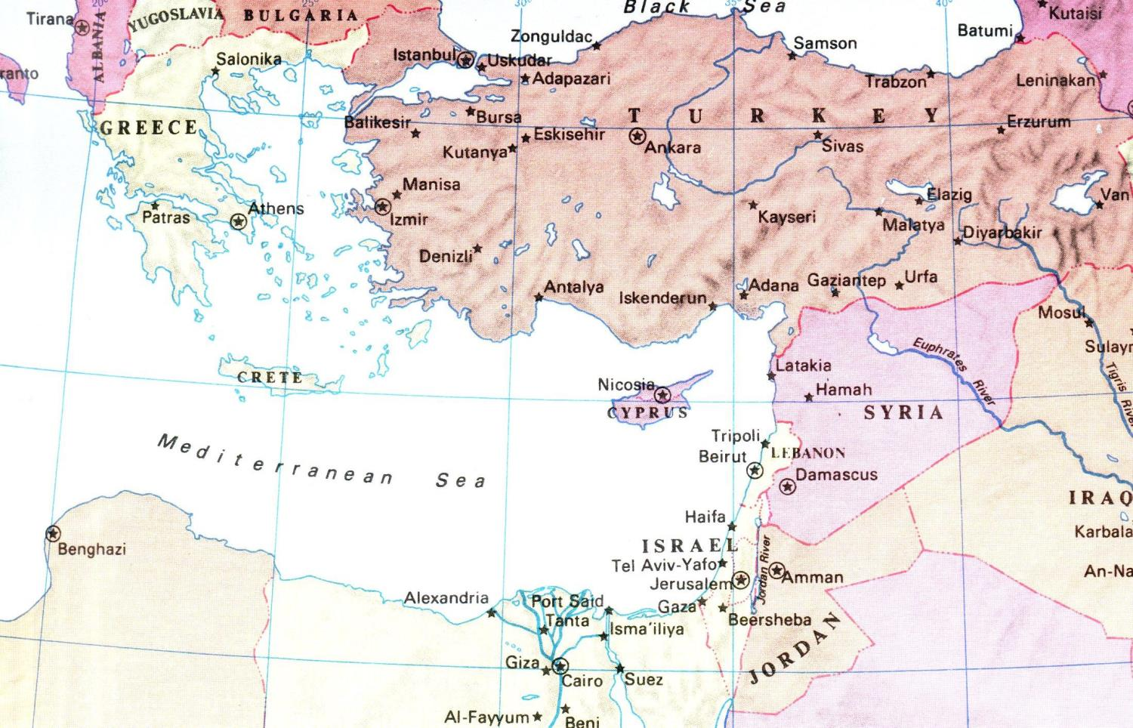

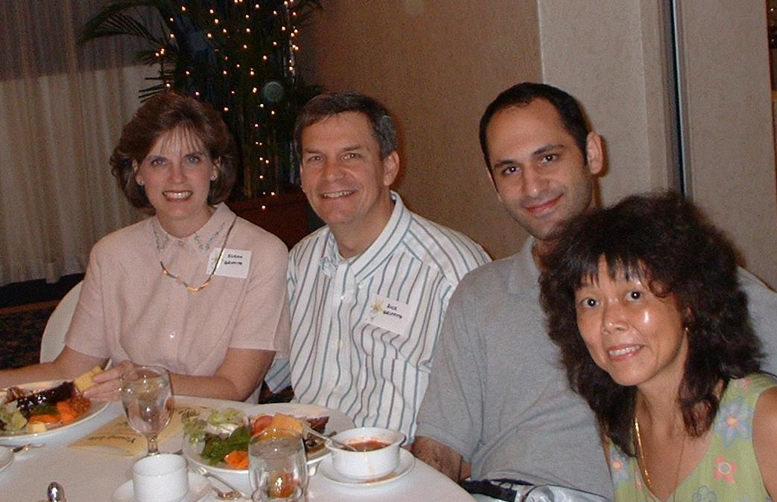
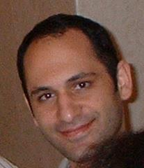

The Lines of Japheth, Ham, & Shem
92
Gomer
Togarmah
Javan
Meshech
Asshur
Lud
Tubal
Aram
Caphtorites
Canaan
Put
Mizraim
Genesis 10
Notes:
All three of Noah's lines had dinner some years back: Susan and Rick (=Japheth) with a couple with an Iranian husband Nick (=Shem) and Chinese wife (=Ham).

Slide 8
The Table of Nations
(Gen. 10)
17
NOAH
Sino
Japheth
HAM
SHEM
Sin
Caucasians
Canaanites
Semites
Sinai
Europeans &
East Indians
Africans &
Asians
Jews &
Arabs

Slide 9
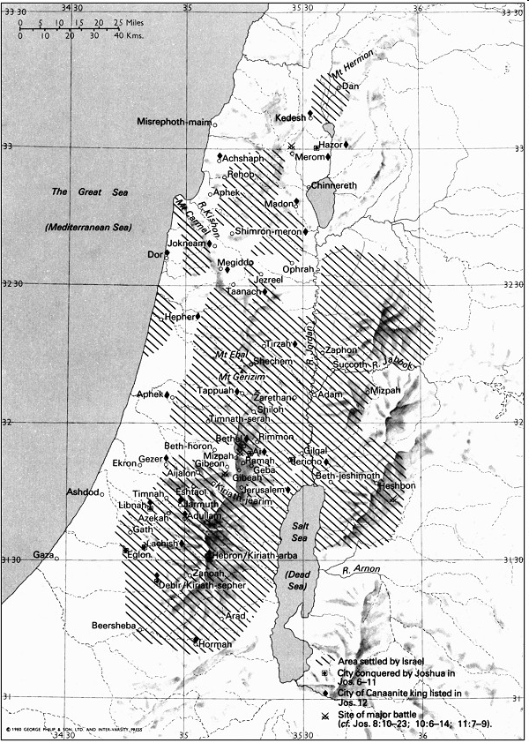
Enemies in Canaan During the Judges
Mesopo
tamians
Sidonians
74
New Bible Atlas
Phoenicians
Amorites
Canaanites
A m o r i t e s
Ammonites
Perizzites
Hivites
Jebusites
Philistines
Moabites
Amalekites
Edomites

Slide 10
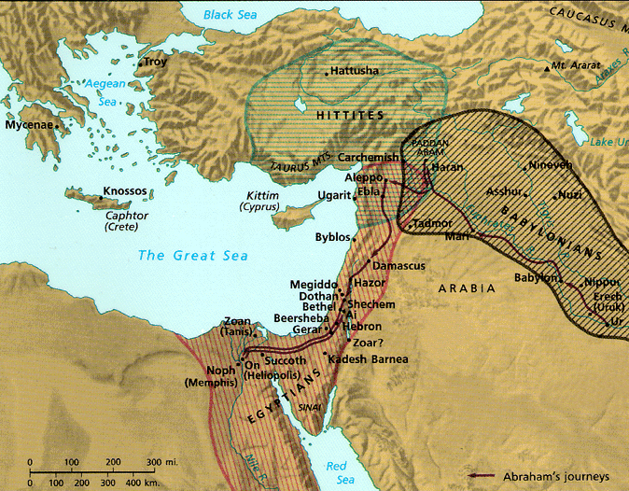
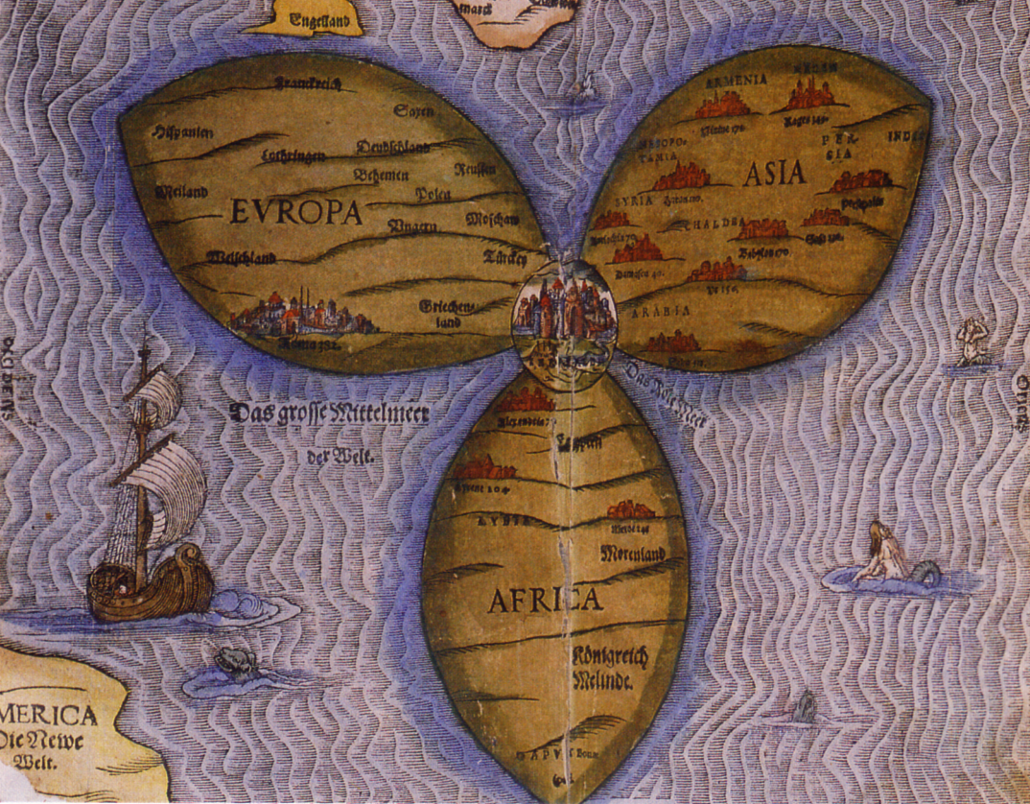
What was Israel's Attitude about the Nations?
Medieval Christians also saw Jerusalem at the centre of the world (AD 1580)
Notes:
Elwood & Yarbrough, Readings from the First Century World, 23; clover leaf map from Beitzel, 203.

Slide 11
What was Israel's Attitude about the Nations?
Readings From the First-Century World, 23
Notes:
Elwood & Yarbrough, Readings from the First Century World, 23

Slide 12
Ten Jewish Levels of Holiness in the Land
"There are ten degrees of holiness. The land of Israel is holier than any other land… in that from it they may bring the Firstfruits and the Two Loaves…"
Israel vs.
Other Nations
10th Most Holy Place
Notes:
Elwood & Yarbrough, Readings from the First Century World, 23

Slide 13
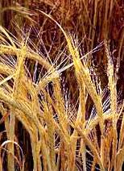
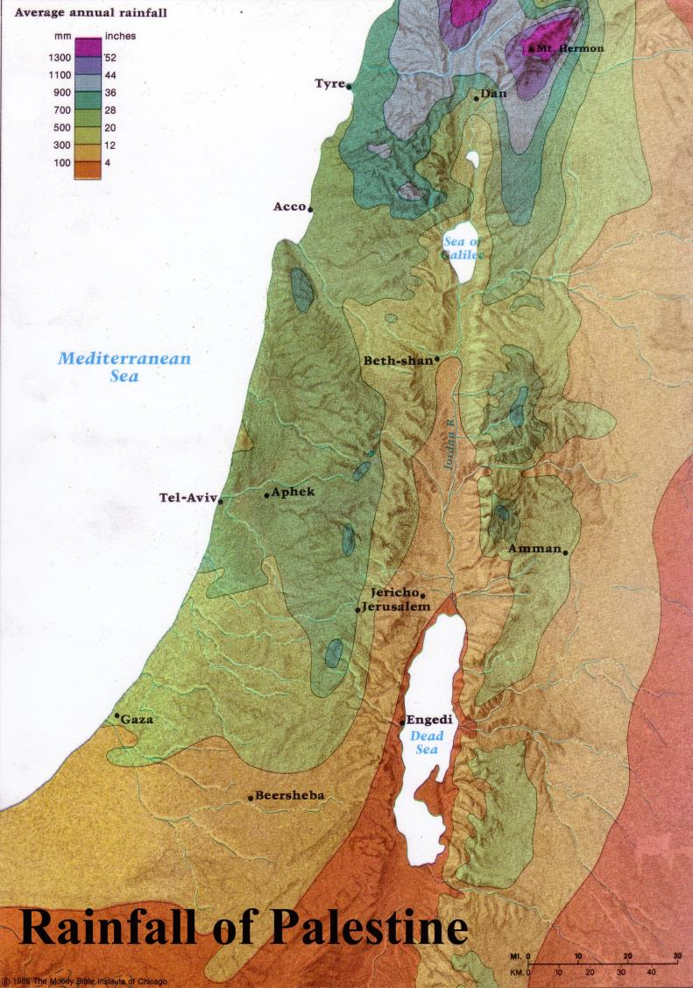
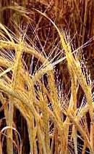
Firstfruits: Wave Sheaf Offering
Harvested in the far north of Israel
Brought down to Jerusalem
Beitzel, Moody Atlas of Bible Lands, 50

Slide 14
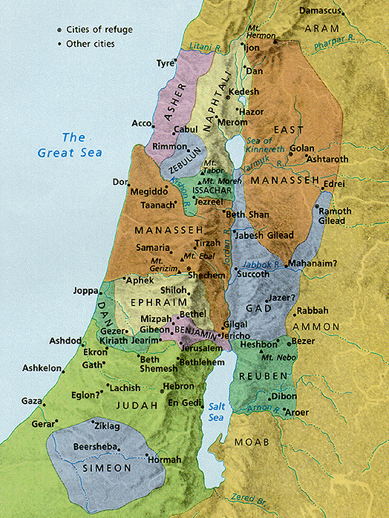
Urban vs.
Rural Areas
Ten Jewish Levels of Holiness in the Land
"The walled cities are still more holy in that they must send forth the lepers [and corpses] from their midst"
9th Most Holy Place
Notes:
Mishnah Tractate Kelim 1.6-9 in Elwood & Yarbrough, Readings from the First Century World, 23

Slide 15
Jerusalem vs. Other Cities
Ten Jewish Levels of Holiness in the Land
"Within the wall [of Jerusalem] is still more holy for there [only] they will eat [the holy food]"
Jerusalem
8th Most Holy Place
Notes:
Mishnah Tractate Kelim 1.6-9 in Elwood & Yarbrough, Readings from the First Century World, 23

Slide 16
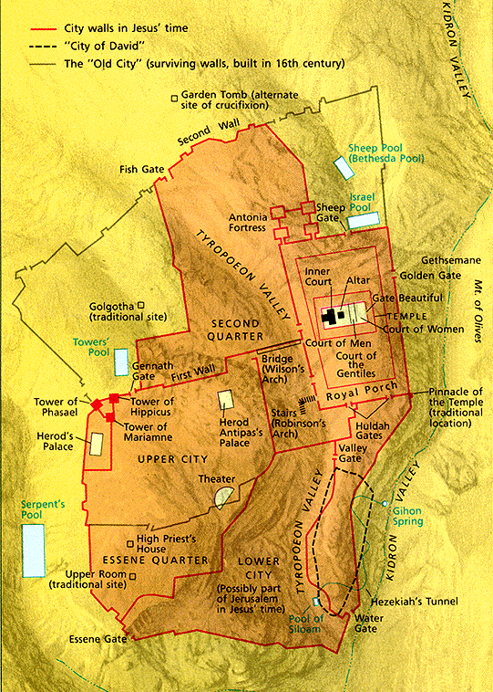
Temple Mount
Ten Jewish Levels of Holiness in the Land
Temple Mount vs. Other Sections
"No man or woman that has a flux, no menstruant, and no woman after childbirth may enter therein."
7th Most Holy Place
Notes:
Mishnah Tractate Kelim 1.6-9 in Elwood & Yarbrough, Readings from the First Century World, 23

Slide 17
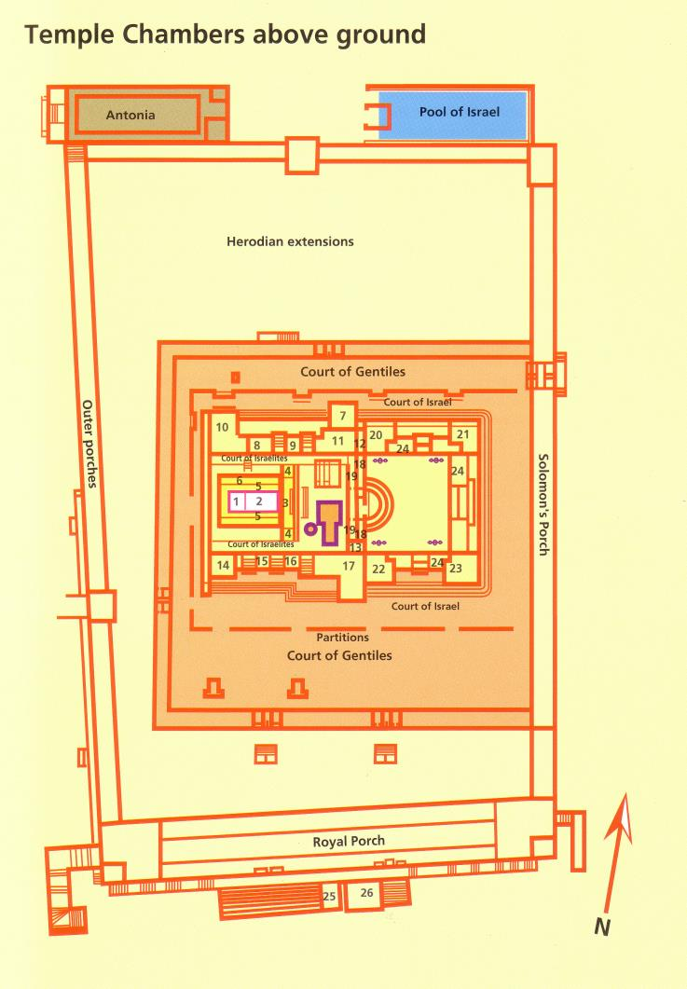
The Rampart
Ten Jewish Levels of Holiness in the Land
The Rampart vs. the Rest of Temple Mount
"No Gentiles and none that have contracted uncleanness from a corpse may enter"
6th Most Holy Place
Notes:
Mishnah Tractate Kelim 1.6-9 in Elwood & Yarbrough, Readings from the First Century World, 23

Slide 18
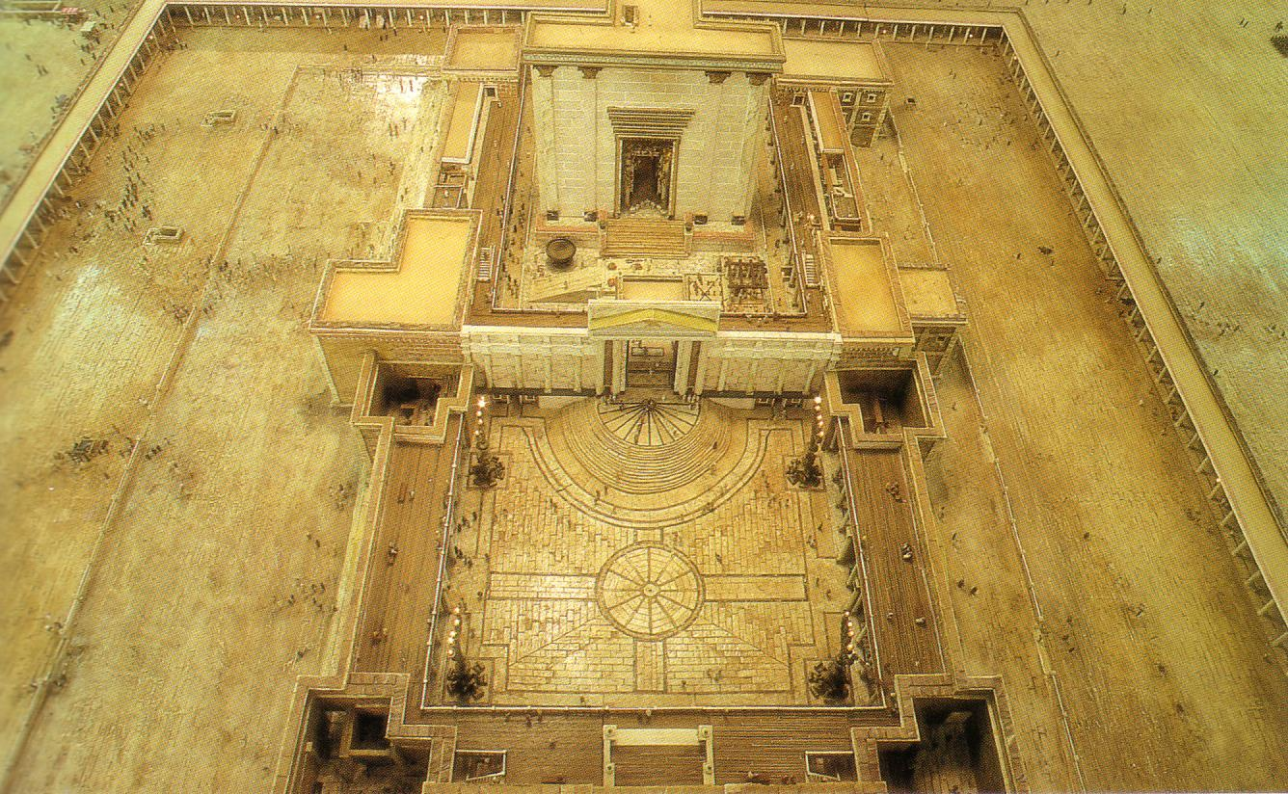
Court of Women
Ten Jewish Levels of Holiness in the Land
Court of Women
This closest place for women also excluded men who had immersed themselves the same day
Priests
Women?/Gentiles
Israelites
Israelites
5th Most Holy Place
Notes:
Mishnah Tractate Kelim 1.6-9 in Elwood & Yarbrough, Readings from the First Century World, 23

Slide 19
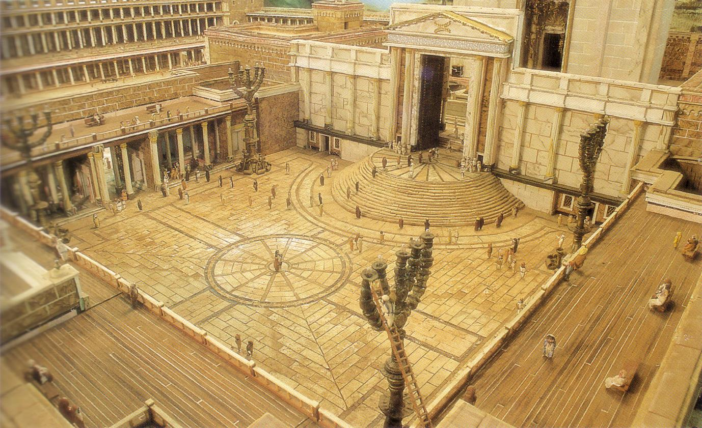
Court of Israelites
Ten Jewish Levels of Holiness in the Land
Court of Israelites
Only men whose atonement was complete could enter (otherwise they needed a sin offering)
4th Most Holy Place
Notes:
Mishnah Tractate Kelim 1.6-9 in Elwood & Yarbrough, Readings from the First Century World, 23

Slide 20
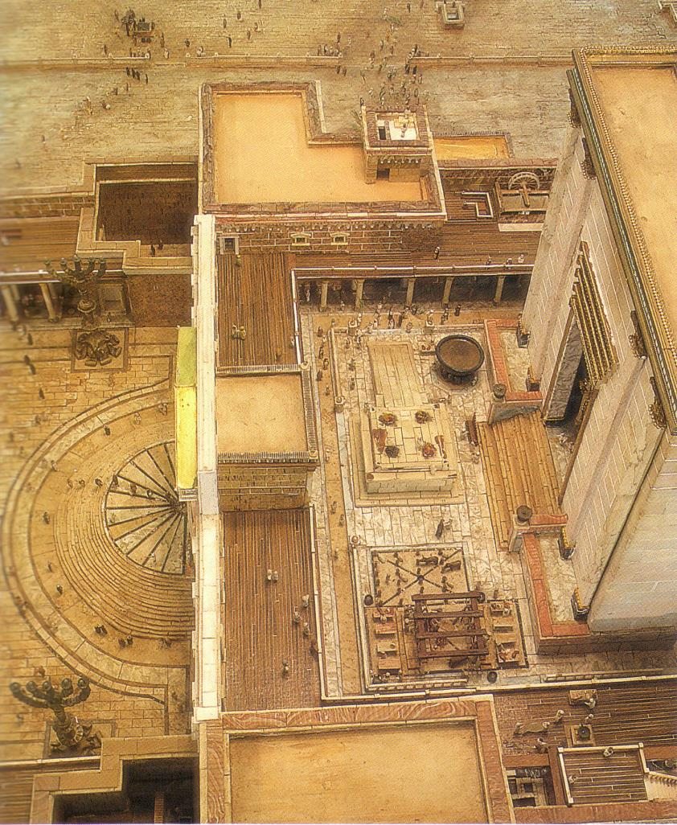
The Inner Temple Court and the steps leading to the Nicanor Gate
Ten Jewish Levels of Holiness in the Land
Court of Priests
Only for priests and men who "must perform the laying on our hands, slaughtering, and waving"
3rd Most Holy Place
Notes:
Mishnah Tractate Kelim 1.6-9 in Elwood & Yarbrough, Readings from the First Century World, 23

Slide 21
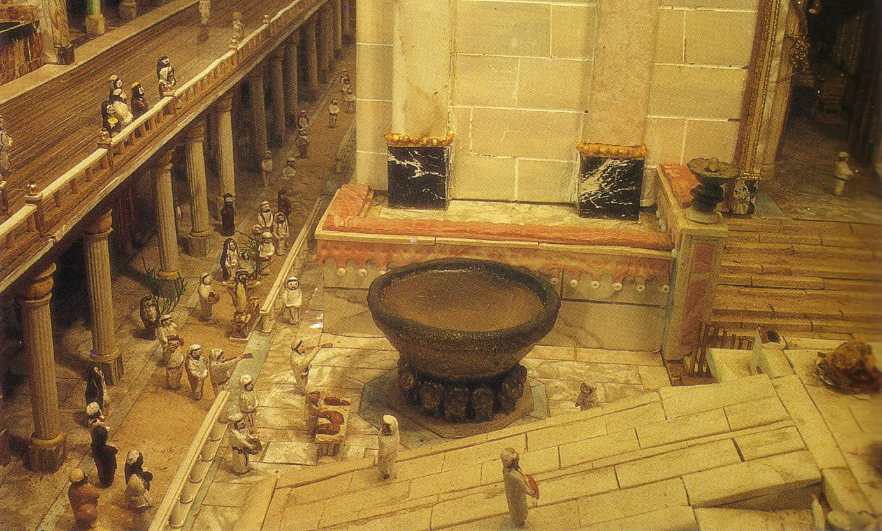
The Great Basin in the Court of the Priests.
Ten Jewish Levels of Holiness in the Land
Between
Porch & Altar
Only priests without blemishes and hair tied could enter here to wash their hands and feet
Porch
Altar
2nd Most Holy Place
Notes:
Mishnah Tractate Kelim 1.6-9 in Elwood & Yarbrough, Readings from the First Century World, 23

Slide 22
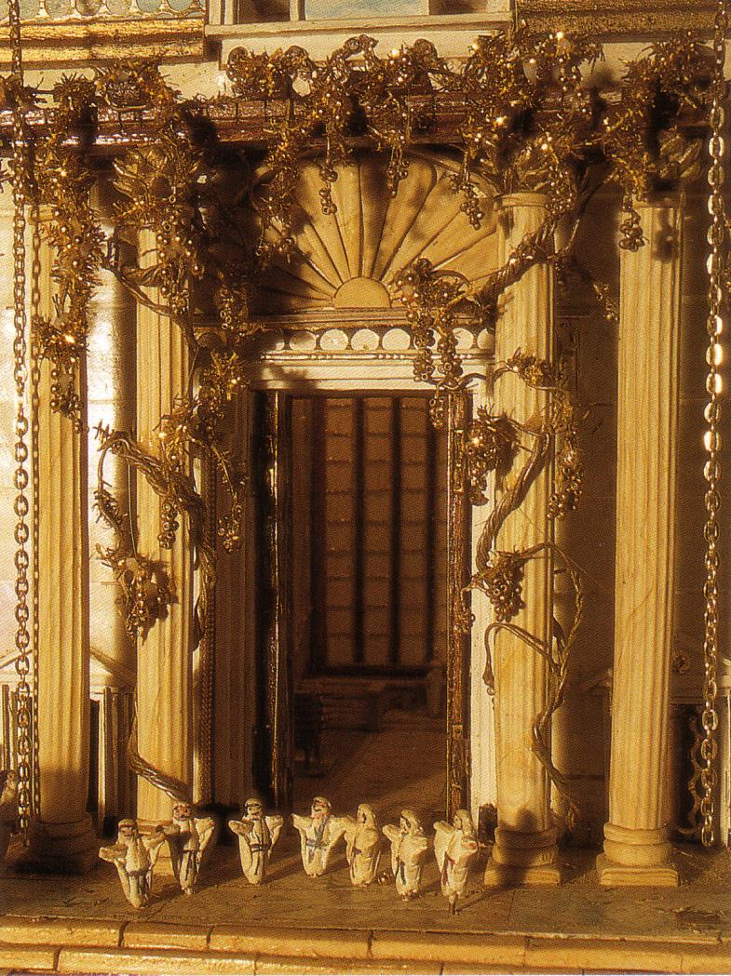
The Great Gates
These led to the temple sanctuary. Only priests with hands and feet washed could enter here.

Slide 23
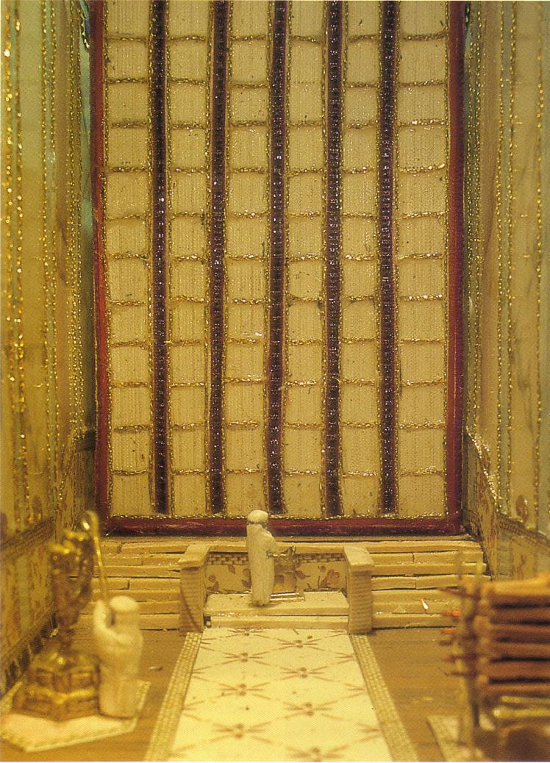
The Holy Place
Ten Jewish Levels of Holiness in the Land
Ten Jewish Levels of Holiness in the Land
The Holy Place
Only priests with hands and feet washed can enter here
Most Holy Place
Notes:
Mishnah Tractate Kelim 1.6-9 in Elwood & Yarbrough, Readings from the First Century World, 23

Slide 24
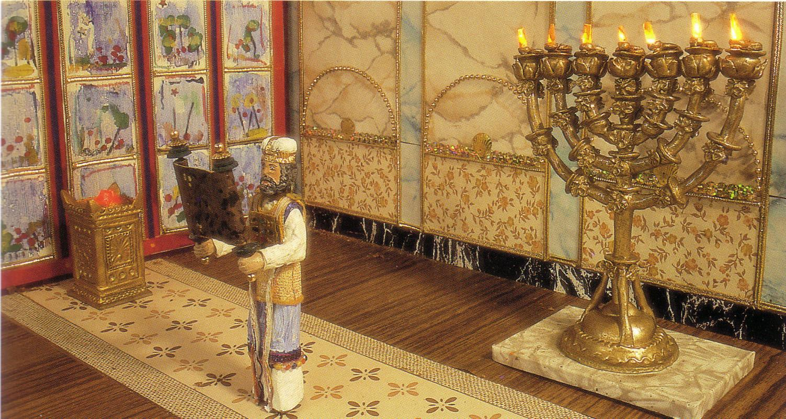
The Holy Place
Ten Jewish Levels of Holiness in the Land
Ten Jewish Levels of Holiness in the Land
The Holy Place
Only priests with hands and feet washed can enter here
Most Holy Place
Notes:
Mishnah Tractate Kelim 1.6-9 in Elwood & Yarbrough, Readings from the First Century World, 23

Slide 25
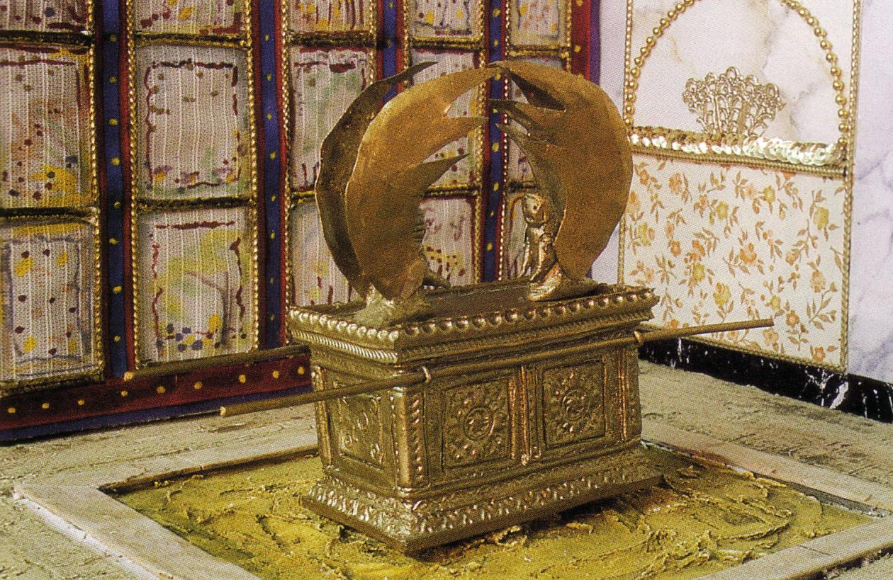
The Holy of Holies
Ten Jewish Levels of Holiness in the Land
Holy of Holies
Only the High Priest could enter behind the veil and only once yearly on the Day of Atonement
Holiest Place of All
Notes:
Mishnah Tractate Kelim 1.6-9 in Elwood & Yarbrough, Readings from the First Century World, 23

Slide 27


OT Backgrounds link at BibleStudyDownloads.org
Get this presentation for free!
Notes:
OT Backgrounds

